Slide 1


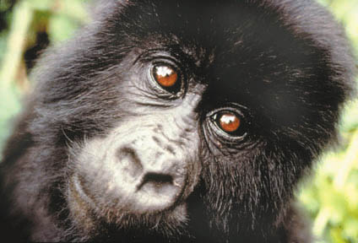
2017
Fundraising Toolkit
“When you realize the value of all life, you dwell less on what is past and concentrate more on the preservation of the future”
-Dian Fossey’s final journal entry

Slide 2
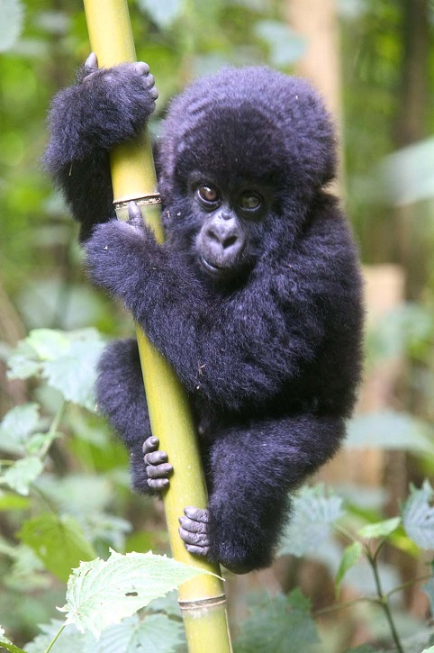
THANK YOU!!
Dear Gorilla Runner,
Thank you so much for participating in the 6th Annual Cincinnati Gorilla Run! This fundraising event benefits the Mountain Gorilla Conservation Fund (MGCF), dedicated to the conservation and protection of the critically endangered Mountain Gorillas in Africa, their habitat, and working with the people around the National Parks. We have been doing this ever since Dian Fossey asked for help back in 1983.
It's Working
When Ruth Keesling took over the work after Dr. Dian Fossey's murder, there were only 248 known mountain gorillas in the world. None of these animals are in captivity. Today, there are an estimated 880 alive. They are the only Great Ape primate that is posting a positive increase in their population numbers!
We appreciate your help in raising the much needed funds to keep our project going and protect the gentle giants of the forest.
Thank you for your support,
Mountain Gorilla Conservation Fund
Contents:
Fundraising Instructions 3
Pledge Letter to Send to Supporters 4
Follow Up Letter 5
Fundraiser checklist 6
Why we do this 7 & 8
Pledge Form 9
Pledge Incentives 10
Social Media 11 & 12

Slide 3
Fundraising Instructions
Online donations:
Visit https://www.crowdrise.com/CincinnatiGorillaRun2017 to set up your online fundraising page.
Click the “Set up your fundraiser” button.
Enter your fundraiser name (your name as an individual fundraiser or the team’s name for a group fundraising page) and contact information.
Personalize your fundraising page to include:
  Your fundraising goal
  Why you are participating in the Cincinnati Gorilla Run
  Include any personal connection to the mountain gorillas
  Upload an image (gorilla picture, training in your gorilla suit, previous year pictures)
Send your fundraising page link to all your friends and family! For your convenience, we’ve provided a pledge letter template.
On your fundraising page, use the social media icons to share with your networks and let them know about your fundraising efforts!
Remember, 10 lucky fundraisers who collect $50+ will be selected to win a Joby GorillaPod.
For additional help and support, email saveagorilla@yahoo.com.
Offline donations:
You can also collect cash donations or checks made payable to MGCF. Record fundraising dollars on the pledge form and drop off at the donations table on event day.
Have questions? We’re happy to help!
Email: saveagorilla@yahoo.com Phone: 720-524-0272

Slide 4
Pledge Letter to Send to Supporters
Hi There!
Remember the movie, "Gorillas In The Mist"? Well, I will be a gorilla for a day participating in the 6th Annual Cincinnati Gorilla Run on April 2nd.
I am raising funds for the Mountain Gorilla Conservation Fund and am asking you to help by making a contribution. I’ve set a personal fundraising goal of $[INSERT GOAL]. Please visit [ADD PERSONAL FUNDRAISING PAGE WEBLINK HERE] to make your tax-deductible donation. Or, why not join me on the day of the event? Visit http://www.cincinnatigorillarun.com/ to register today!
Why are we doing this?
The annual Cincinnati Gorilla Run fundraiser has truly shown success stories. MGCF has been able to open the Ruth Keesling Wildlife Health and Research Center, which is the largest wildlife veterinary education facility in Africa. It includes a Bio Hazard Lab, which houses wildlife infectious diseases for research. Today, we have graduated 36 wildlife veterinarians through our programs and this has proven successful as the Mountain Gorilla is the only great ape primate in the world posting positive numbers in its population. When Ruth met the late Dr. Dian Fossey there were 248 Mountain Gorillas left in the world; today an estimated 880 are with us. Let’s keep doing good things together!
I thank you in advance for your support and really appreciate your generosity!!
Cincinnati Gorilla Run main web site: http://www.cincinnatigorillarun.com/
If you would like more information about the Mountain Gorilla Conservation Fund and how funds raised through the Cincinnati Gorilla Run are used, please visit www.saveagorilla.org.
Please forward this email to as many people as you can and encourage them to donate!

Slide 5
Follow Up Letter
Hi [NAME],
I hope you’re doing well. I’m emailing to follow up with you on the donation request I made for the Cincinnati Gorilla Run coming up on April 2nd. The event benefits Mountain Gorilla Conservation Fund, dedicated to the conservation and protection of the critically endangered Mountain Gorillas in Africa, their habitat, and working with the people around the National Parks.
My fundraising goal is $[INSERT GOAL]. If you’d like to contribute, please visit [ADD PERSONAL FUNDRAISING PAGE WEBLINK HERE] to donate online quickly & securely.
For more information about the 5K fun run in a full gorilla suit, go to http://www.cincinnatigorillarun.com/.
Thank you in advance. Your support is greatly appreciated!
[Your Name]

Slide 6
Fundraiser Checklist
HAVE A PLAN AND STICK TO IT
The most effective way to achieve your fundraising goal is to create a detailed plan outlining the steps you'll need to complete in order to meet your objectives. Remember, sticking to your plan will ensure success!
Set a goal of at least $250.
Start early so you can give people ample time to donate.
Make it personal. Educate your donors on why this cause is so important to you.
Stress the benefits of contributing.
Ask BIG before going small.
Never feel guilty about asking for donations.
Keep track of who you’ve asked and follow-up.
Always ask contacts to forward your email to others.
Keep donors updated on your progress.
Send thank you notes!
Don’t be afraid to ask everyone you know
Start by making your own contribution to show other donors that you are right there with them!
Friends, family members, and co-workers. You never know who is willing to contribute!
Ask your employer if they have a matching gift program or would be willing to make a corporate donation…have your donors ask their employers too!
Email local businesses that might be interested in your cause. Ask them to sponsor you.
Use social media
Update your Facebook status to let your friends know you are raising money for the mountain gorillas.
Tell your Twitter followers about your fundraising efforts.
Keep everyone up to date on progress towards your goal.
Set a Fundraising Goal
I will raise $ (we recommend $250.00) by 4/2/17
I will contact people in order to reach my goal.
Estimate the average contribution will be $50 and that 50% of the people you contact will contribute. If you plan to raise $250, you only need to contact 10 people. Simple!

Slide 7
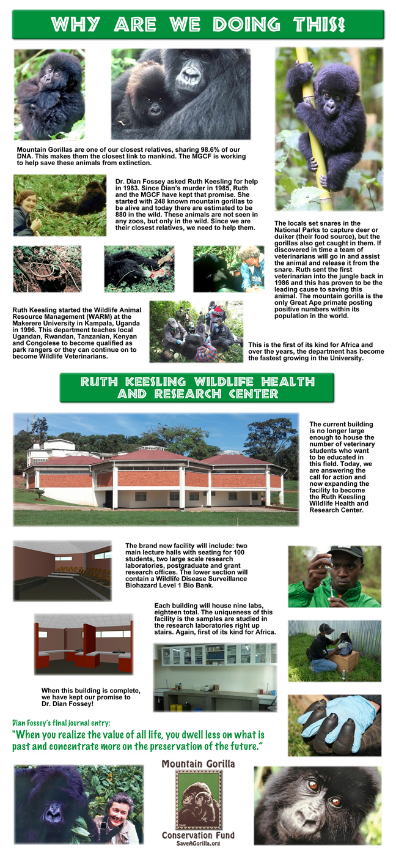

Slide 9
Pledge Form
Cincinnati Gorilla Run April 2, 2017
Participant Name: ______________________ Team Name: _____________________
Phone Number: ________________________ E-mail: ________________________
Please select the project you would like your fundraising dollars to support:
Ruth Keesling Wildlife Health and Research Center
Veterinary Education
Unrestricted – MGCF can direct where most needed
Cash
Check
Sponsor’s Name | Address / City / State / Zip | Email | Amount Pledged
 |  |  |  | □ □
 |  |  |  | □ □
 |  |  |  | □ □
 |  |  |  | □ □
 |  |  |  | □ □
 |  |  |  | □ □
 |  |  |  | □ □
 |  |  |  | □ □
 |  |  |  | □ □
 |  |  |  | □ □
 |  |  |  | □ □
 |  |  |  | □ □
 |  | Total
  Please make checks payable to: MGCF
Bring this form to the Cincinnati Gorilla Run on April 2, 2017
The donor’s name and address or email must be clearly printed and complete on the form above to receive a tax receipt from Mountain Gorilla Conservation Fund.

Slide 10
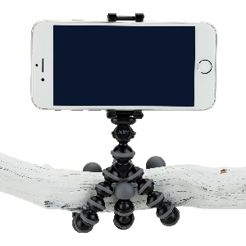
Pledge Incentives
Fundraise $50 or more and you’ll be entered to win your choice of the following prizes:
GorillaPod Original tripod
GripTight GorillaPod Stand tripod and mount for XL smartphone
GripTight GorillaPod Stand tripod and mount for regular smartphone
Raise at least $50 online to your individual fundraising page by 3/24/17 and you’ll be entered into the drawing for a chance to win the prize. Tripod styles are available on a first come, first served basis at the DONATIONS tent on event day. You will receive an email prior to the event if you are one of our lucky 10 winners!
Interested in earning a free entry? Start fundraising here!

Slide 11


Social Media
Like Cincinnati Gorilla Run on Facebook so you can share our posts with your family and friends: facebook.com/CincinnatiGorillaRun.
Follow Cincinnati Gorilla Run on Twitter: twitter.com/cincygorillarun
Follow Mountain Gorilla Conservation Fund on Pinterest: pinterest.com/saveagorilla/
Keep a regular presence on social media. Post often about the Gorilla Run, mentioning why you are doing the event, sharing photos & updates, gorilla facts, etc. No need to ask for donations each post, but keep the Gorilla Run fresh in people’s minds so that followers remember to contribute or participate with you.
Pictures are a great way to capture attention on social media! Post pics in your gorilla costume for a great response!
An effective ways to get others to support you is to make the first contribution yourself! People are more likely to give if there's already some money donated to your fundraising campaign.
Make sure to always include @CincinnatiGorillaRun in posts about the event.
Share your personal fundraising page.
On Twitter & Facebook, use the hashtags #CincyGorillaRun & #RunLikeAGorilla
Share a video of yourself in your gorilla suit!

Slide 12
Social Media Cont.
Suggested Facebook posts:
Learn more about why I’m running in a gorilla suit for @Mountain Gorilla Conservation Fund www.facebook.com/MountainGorillaConservationFund
Why @CincinnatiGorillaRun? To save the remaining 880 mountain gorillas left in the world! #RunLikeAGorilla http://www.cincinnatigorillarun.com/
I’m dressing like a gorilla to save a gorilla! @CincinnatiGorillaRun April 2nd. #RunLikeAGorilla #CincyGorillaRun http://www.cincinnatigorillarun.com/
Join me for fun at the @CincinnatiGorillaRun! http://bit.ly/cincygorillarun17
I’m doing the 2017 @CincinnatiGorillaRun because…
Can’t join me at the @CincinnatiGorillaRun on April 2nd but still want to be involved? Contribute to my fundraiser to help save a gorilla! [Insert personal fundraising page link]
#CincyGorillaRun
#RunLikeAGorilla
#SaveAGorilla

